Slide 1
Multimodal Publishing with Scalar: Part 1
ARL Digital Scholarship Institute, Summer 2018
Dan Tracy and Janet Swatscheno

Slide 2
What is Multimodal Publishing?
What do we mean by multimodal publishing?
Digital publications that bring together text with images, video, other media…
…that provide different ways for readers to engage with or navigate the content.
”Multimedia scholarship, although it encompasses many forms, might best be understood as work that refuses the print-digital binary. It is by definition beyond print, even while text often remains a crucial element of such work. It typically includes the following elements: multiple media(text, sound, image, moving images), user interactivity, a networked or database structure, nonlinear components, and a heightened attention to aspects of design, aesthetics, or form.”
McPherson and Anderson
Notes:
Janet start

Slide 3
What Does Multi-Modal Publishing Entail?
For scholarship, it enables integration of multimedia evidence in ways not possible in print scholarship and also provides the audience with ways to engage that media.
Related terms: scholarly multimedia, web texts, hypertext
Comparative forms: Exhibits (covered in Omeka session), Digital / critical editions (covered in TEI session)
Also new platforms for more traditional, non multimodal publications like text-only books: Manifold, Pressbooks

Slide 4
History and Common Platforms
Vectors -- > Scalar
WordPress
Drupal / HTML Hand Coding
Fulcrum
Upcoming: Vega

Slide 5
Activity 1: Site Analysis
In groups of 2-3, look at the two multimodal publications assigned to your group.
Identify common features and structures, and issues that you think might be common concerns (in terms of process, information organization, social and legal concerns, technical requirements) with the two different sites.
Also identify some areas where the two sites diverge in these areas.
Notes:
Janet end

Slide 6
Core Concerns for Multimodal Publishing: Copyright
Use of in-copyright media (which will include most video/audio media) can pose difficult fair use questions, but there are a number of “best practices” documents available that point to an emerging consensus.
Statement of the Fair Use of Images for Teaching, Research, and Study by the Visual Resources Association
Code of Best Practices in the Fair Use for Visual Arts
Key theme in best practice: use of in copyright works should not be “merely illustrative”; they should be important to the argument (have specific accompanying critical commentary of the specific media or otherwise be clearly necessary to the purpose). “Merely illustrative” = decorative, or easily interchangeable (do I need this specific picture of a dog, or would any dog do?).
Columbia Fair Use Checklist

Slide 7
Core Concerns for Multimodal Publishing: Discovery of Media Content
Where is it?
DPLA, digital repositories, born-digital material online, analog material that needs to be digitized… Any given project may need to draw from multiple sources.
What is the quality of the available digital versions?
The more scholarly and final the expected product (vs. say classroom examples that are not made public), the more likely you need high quality digital versions.

Slide 8
Core Concerns for Multimodal Publishing: Metadata, Data Curation, File Management
What is the quality of the metadata of the digital media you have? Does it need remediation or enhancement?
How are you tracking your metadata and what level of metadata description do you need in the publication itself?
How are you storing your files? Are you following file name conventions?
Use of spaces and special characters in file names can cause buggy behavior in many digital systems, including Scalar!

Slide 9
Core Concerns for Multimodal Publishing: Writing Process
Integrating text and multimedia requires different writing strategies than a normal essay.
Must think through issues of relationship of text and media.
Must think about hypertext navigation of content and not just linear reading of the text when designing organization.
A scholarly publishing platform is not a drafting tool.
A scholarly publishing platform is not a drafting tool.
A scholarly publishing platform is not a drafting tool.
A scholarly publishing platform is not a drafting tool.
A scholarly publishing platform is not a drafting tool.
A scholarly publishing platform is not a drafting tool.

Slide 10
Core Concerns for Multimodal Publishing: Varying Degrees of Technical Difficulty
Out of the box platform? (relatively low overhead; technical difficulties dependent mainly on usability of author interface)
Do you need modifications to an open source platform? (i.e. need to hire a programmer)
Do you need a hand-coded site (even more programming needs)?

Slide 11
Core Concerns for Multimodal Publishing: Sustainability
Who is responsible for updating/maintaining content?
Static publication vs. publication involving content modifications or additions over time
Minimal even for static publications: ensuring links continue to function, media works
Who is responsible for storing the content?
How long should it be available? Who will preserve it? Can it be preserved—or rather in what ways can it be preserved and in what ways can it not?

Slide 12
Ethical concerns
Content needing community engagement
Sensitive cultural material
Traditional Cultural Expression
How will communities access the content?
Efforts to address ethical concerns:
Mukurtu Platform
Data and Analytics
What information will be gathered about readers? Are you compromising privacy?

Slide 13
Accessibility
Universal Design
Best Practices
Organizing Content
Images
Multimedia
Accessibility Statements
Resources:
BCcampus Open Accessibility Toolkit: https://opentextbc.ca/accessibilitytoolkit/
WebAIM: https://webaim.org/intro/
Notes:
Janet
Universal Design is the process of creating products (devices, environments, systems, and processes) that are usable by people with the widest possible range of abilities, operating within the widest possible range of situations (environments, conditions, and circumstances).
Best Practices that are most relevant to Scalar
Organizing content
Logical ways of organizing content
Use chapters, headings, subheadings, etc.
Images
Alt text for functional images
Avoid text descriptions for decorative images
Multimedia
Videos: transcripts
Accessibility Statements
An accessibility statement acts as resource for those who have questions about the accessibility features of your resource. It should provide an overview of accessibility features and contact information in case there are any problems.

Slide 14
Intro to Activity 2: Strengths of Scalar
Multimedia integration with text.
Annotation of media.
Creating “paths” through content for readers, supplemented by other ways of interlinking content like tags.
Relatively easy to do these things “Out of the Box” without hiring a graphic designer, web developer, programmer, etc.—though if you could use those people to make something more elaborate.
Flexibility.
Notes:
Janet start

Slide 15
Activity 2: Map Out a Multimodal Site for Scalar
Sort through the sample text and media content provided to plan out a site on a topic.
Map out the structure of the site on the large tablet. Use smaller sticky notes to represent different types of content—different colors for different types of content (media, annotation, main body text).
Represent distinct pages by drawing a line around a set of sticky notes.
Represent paths from page to page with arrows.

Slide 16
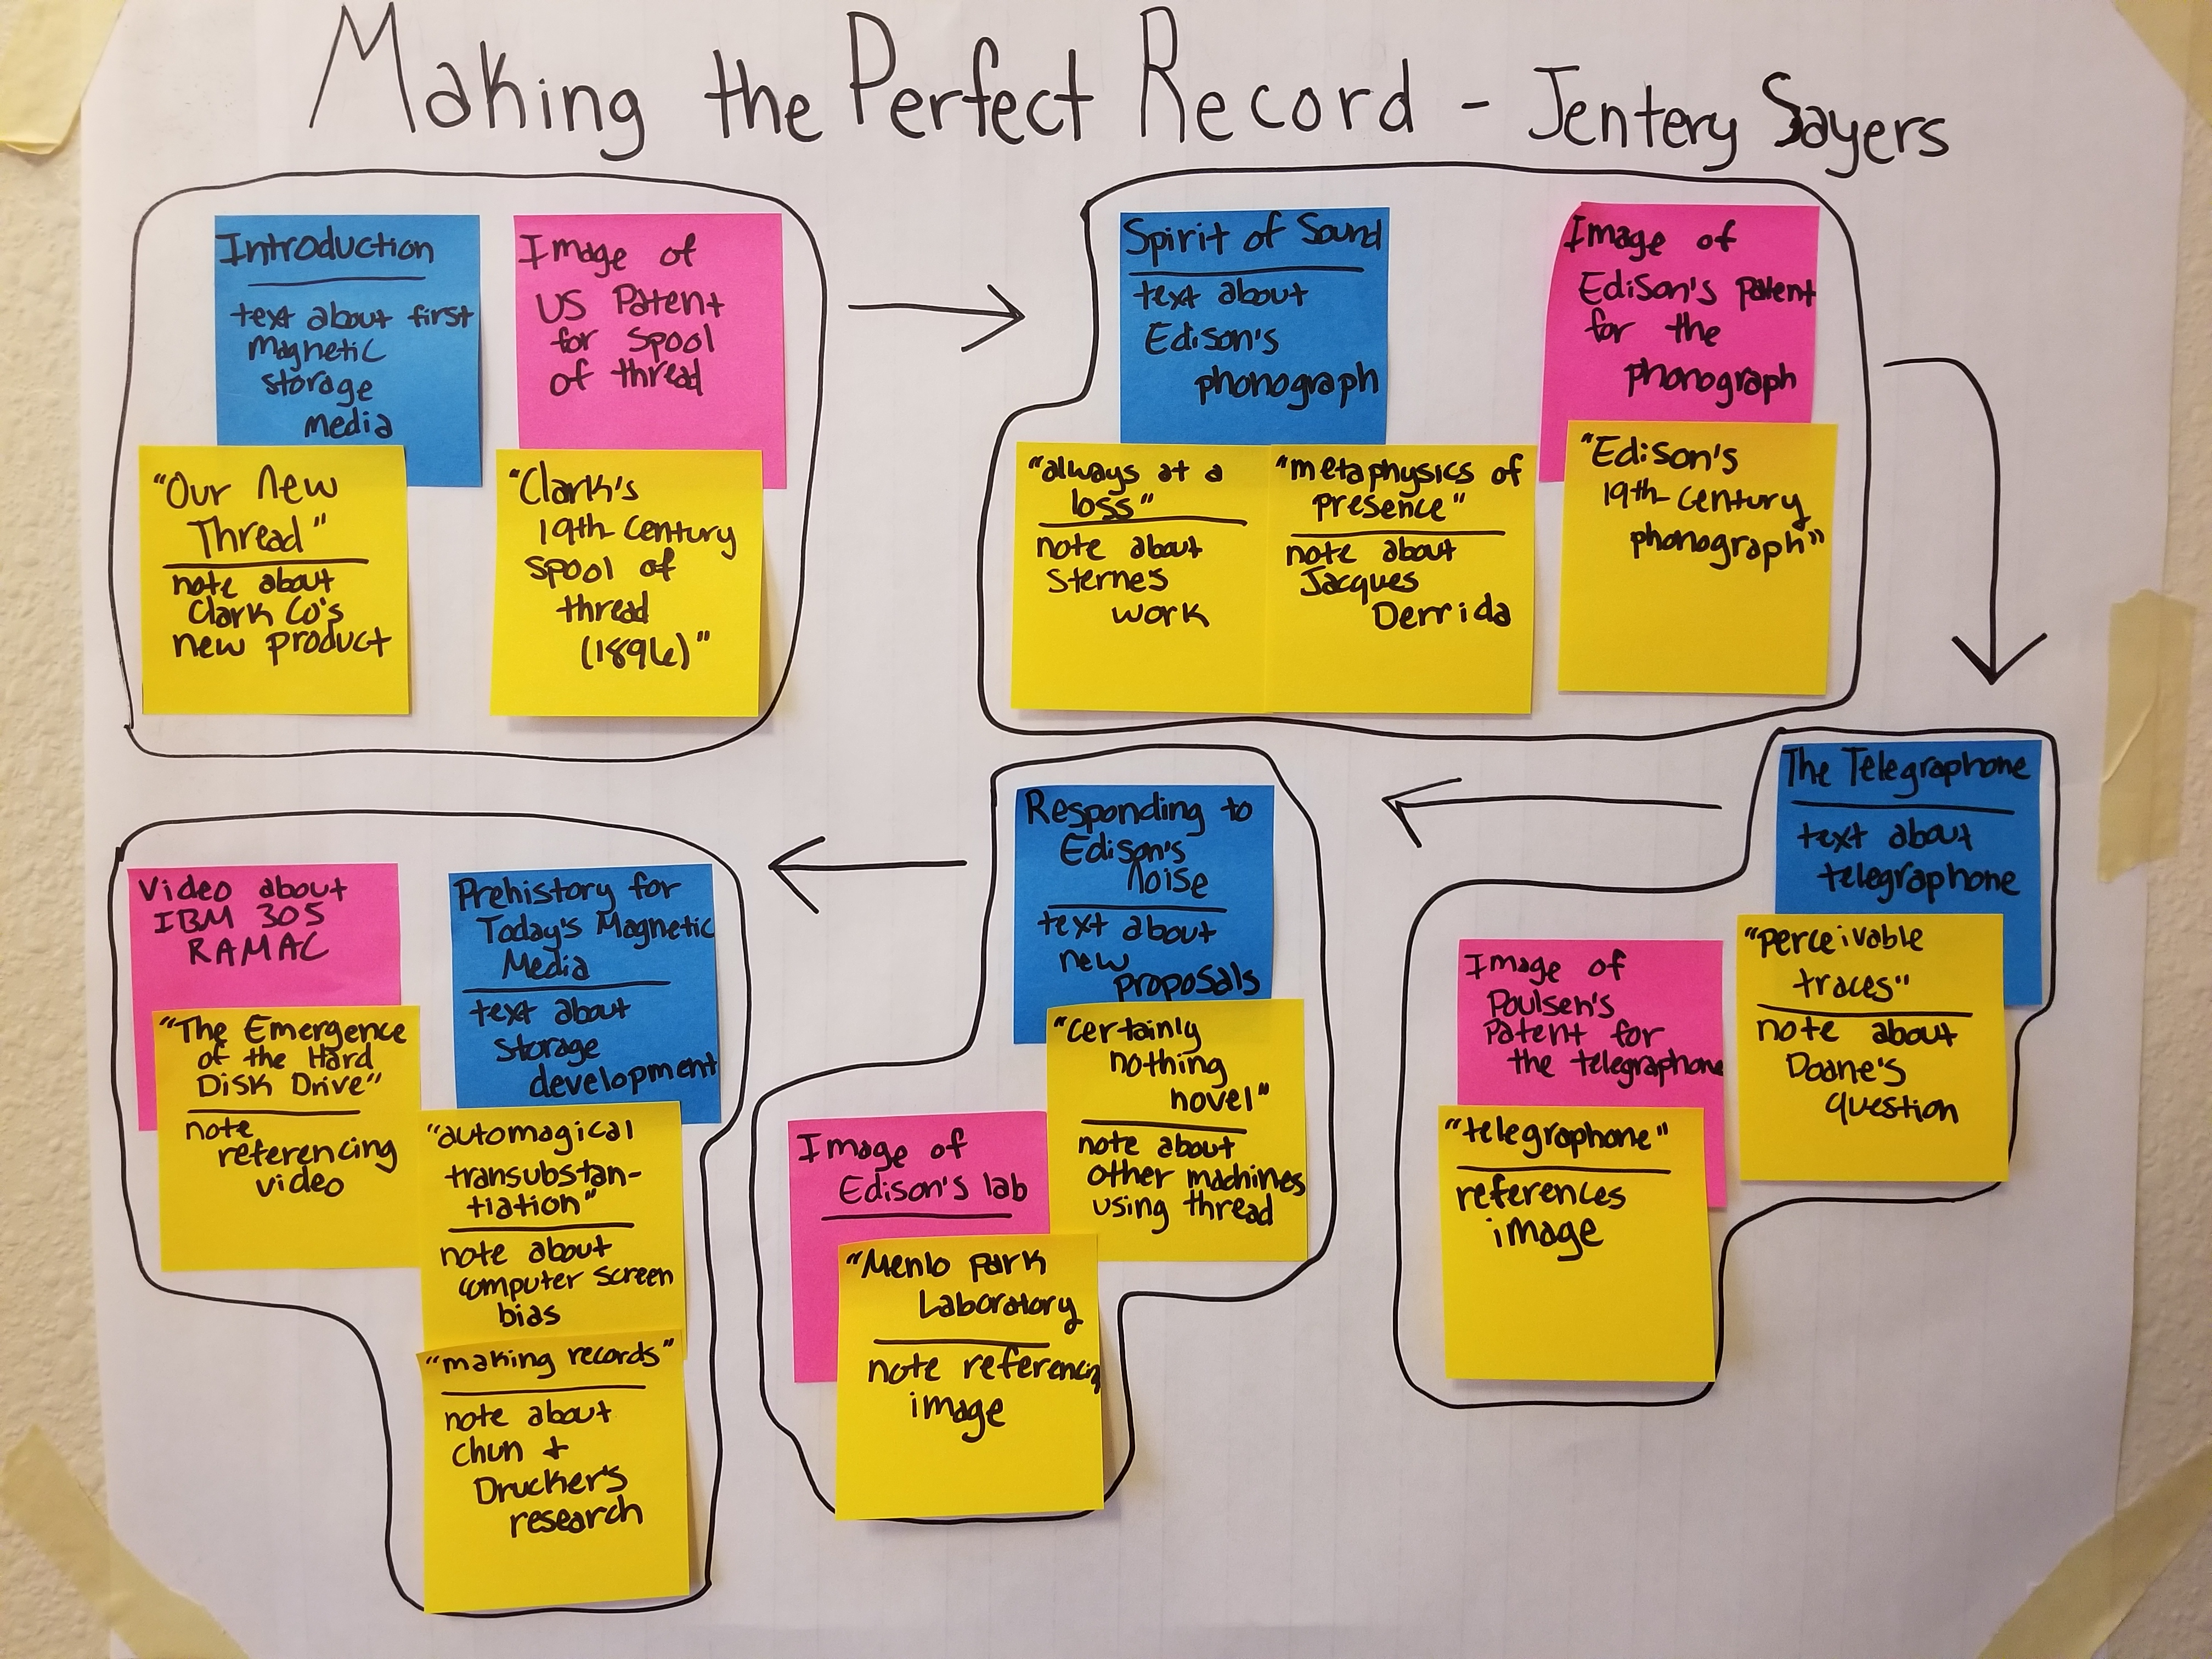
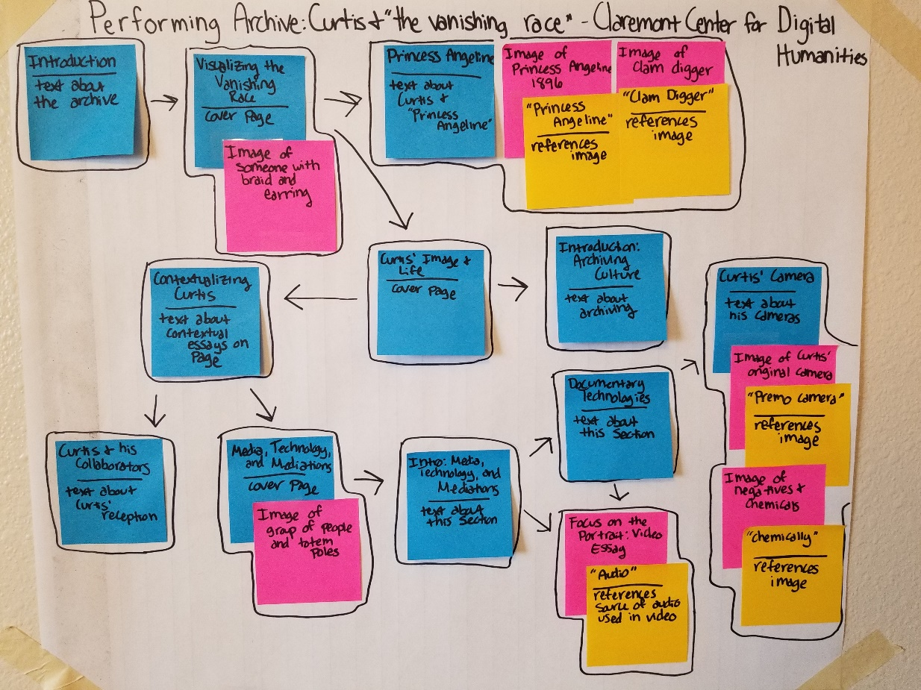
Activity 2: Examples (Yours need not be this tidy!)
In examples: blue = text, pink = media, yellow=annotation. Drawn boundaries represent pages and arrows represent paths. The example on the left represents a simpler single-path essay, whereas the second involves several reader choices about branching off.

Slide 17
Discuss….
How do you feel about your experiences with multi-modal publishing thus far?
Any Questions about process and tools for multi-modal publishing?
Thoughts?

Slide 18

Break!
Please make sure your Scalar account is set up and activated before we return:
http://scalar.usc.edu/works
Keep downloaded text/media from Activity 2 on your laptop for use in Scalar!

Slide 19
Multimodal Publishing with Scalar: Part 2
Introduction to Scalar and Building a Multi-Modal Publishing Project

Slide 20
Scalar: What Is It?
EXAMPLES:
https://scalar.lehigh.edu/kiplings/index
http://digitalpaxton.org/works/digital-paxton/introduction?path=index
http://freedoms-ring.org/
http://scalar.usc.edu/works/growing-apart-a-political-history-of-american-inequality/index
Notes:
Janet start – revisiting what Scalar is slide

Slide 21
Site Planning
What are the primary goals of my website?
Who are the primary and secondary audiences?
What sections will the site include?
What will I do with the items on this website?

Slide 22
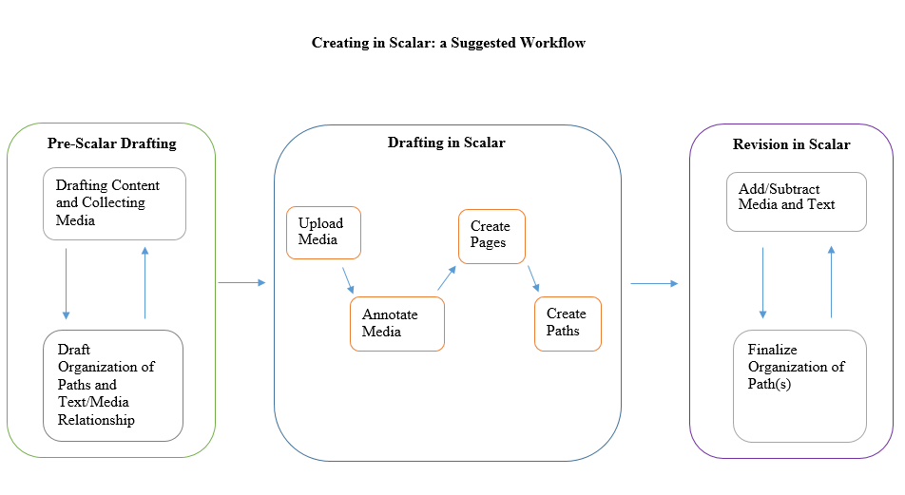
Productive workflow in Scalar?
By Dan Tracy

Slide 23
Structure of a Scalar site
Media
Pages
Paths
Book

Slide 24
Multimedia Support: Copyright
Intentional support for integration of multimedia in ways that meets fair use criteria if the material is copyrighted and you have a fair use case.
Rights issues review
Public Domain
Licensed for re-use (Creative Commons or otherwise)
Fair use of copyright-protected works

Slide 25
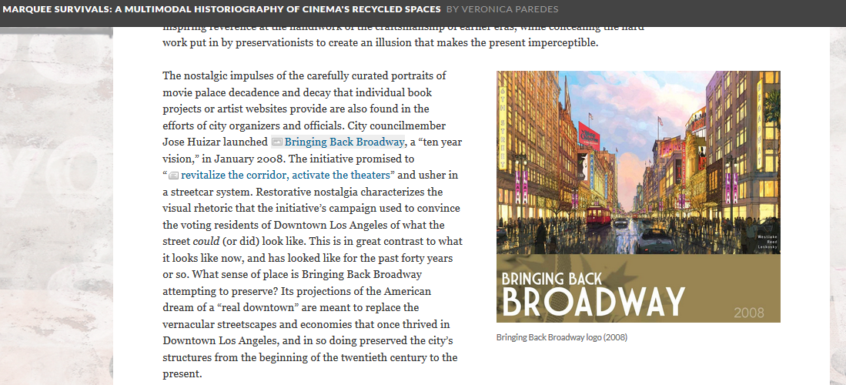
Ways to Use Media In Scalar: Commentary/Critique

Slide 26
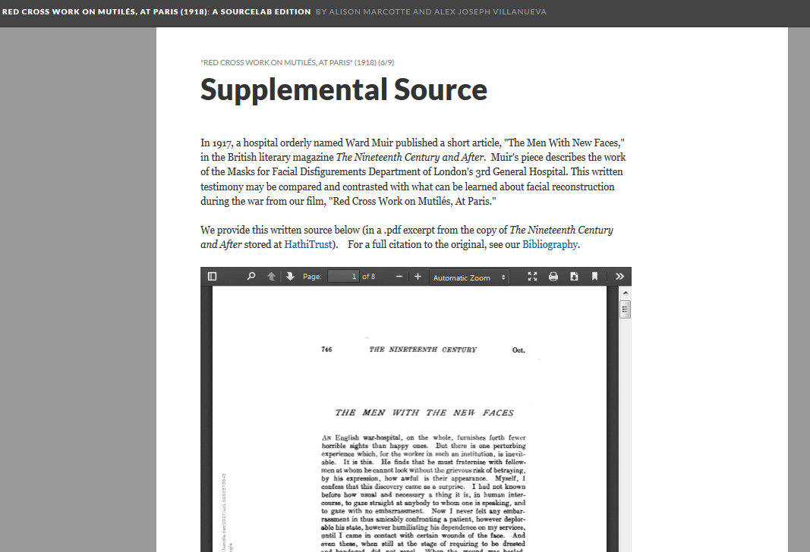
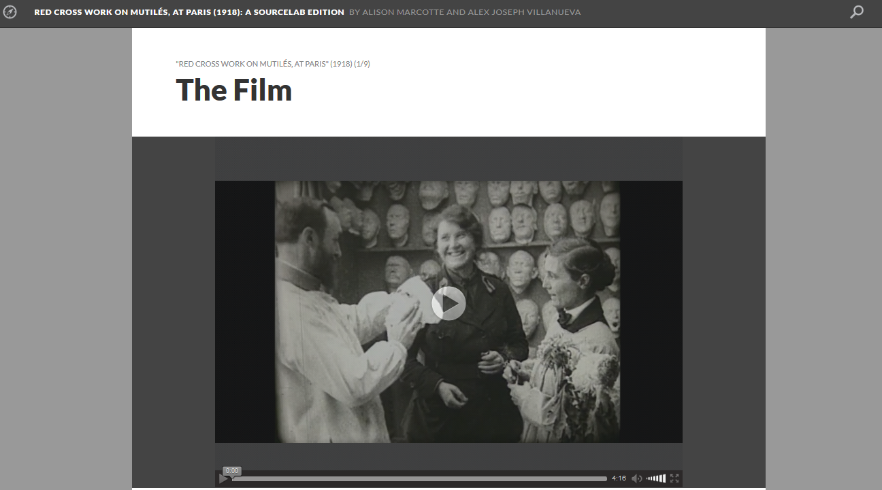
Ways to Use Media In Scalar: Include the Original Text

Slide 27
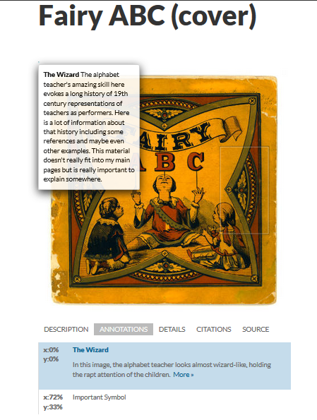
Ways to Use Media In Scalar: Annotation
*“Scholarship” in this annotation totally made up for example purposes!

Slide 28
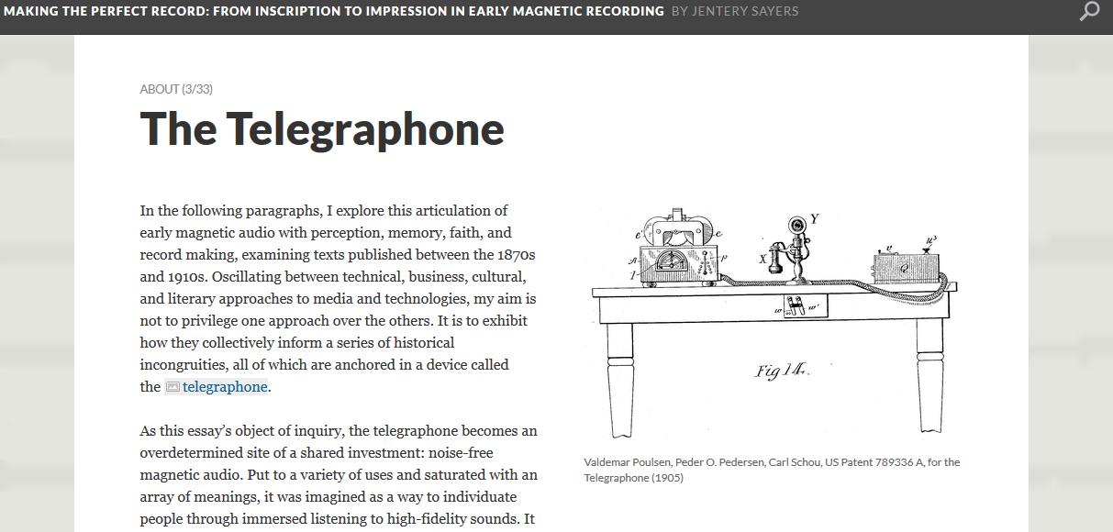
Ways to Use Media In Scalar: Illustration

Slide 29
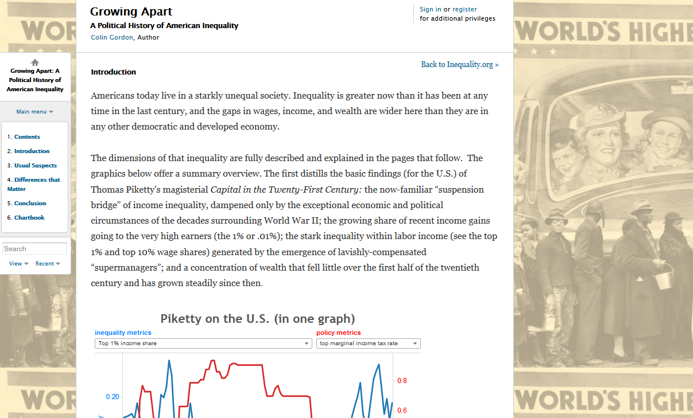
Ways to Use Media In Scalar: Background

Slide 30
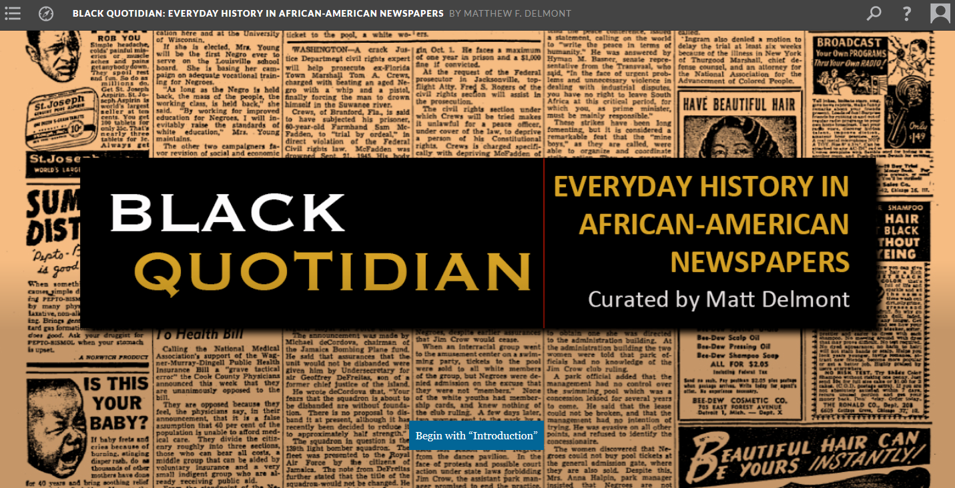
Ways to Use Media In Scalar: Title Page/Splash Page

Slide 31
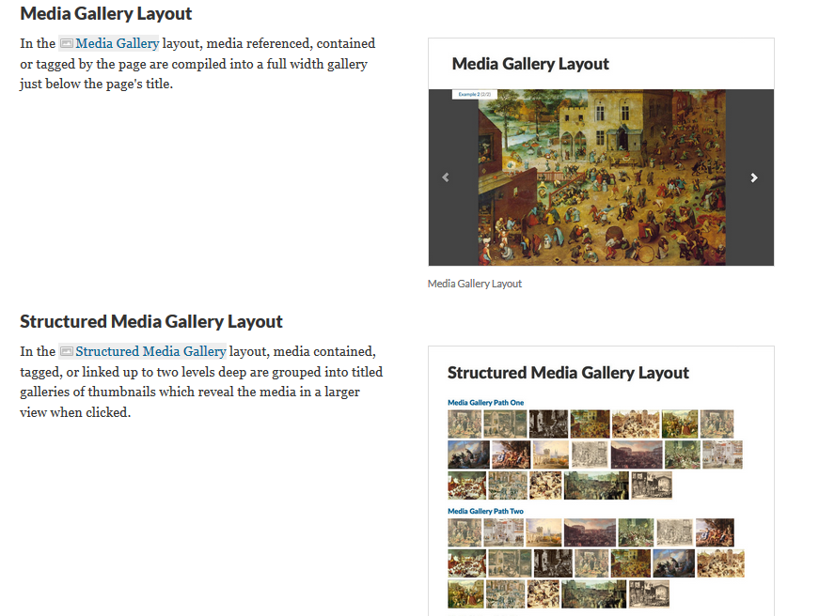
Ways to Use Media in Scalar: Media Galleries
Notes:
End Janet

Slide 32
Source for Data
Use provided example content in "Scalar_Examples.docx":
Text from Wikipedia article, "History of Science and Technology"
List of potential media materials and sources at the end of the document
Select a portion of the text you want to use and then find/download videos, images, etc. from list

Slide 33
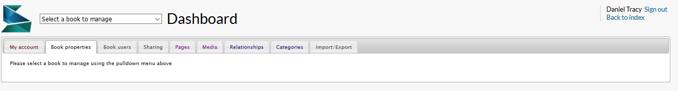
Scalar Dashboard Tour
To edit an existing book, select from the dropdown or go to My Account.
To create a new book, go to my account and enter the title.
Book properties, Book Users, Sharing.

Slide 34
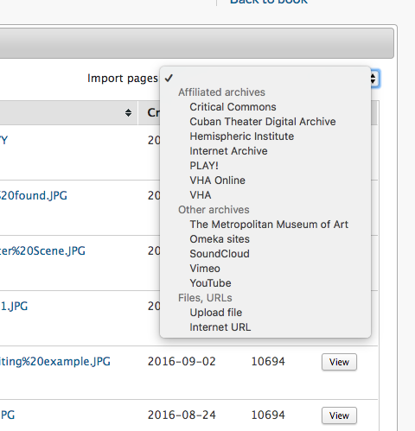
Step 1: Upload Media
Importing from partner archives.
Search by title to select file.
Pulls in metadata, but can edit/supplement.
File remains on partner archive server.
Direct upload (limit 2MB).
Hosts file in Scalar.
Must supply all metadata.
Accessibility note: be sure you have a good description field in the metadata for screen readers!

Slide 35
YOUR TURN: Upload media for your site
Please include at least one image and one video or audio file, and 3-5 items total.
Problem uploading an image file? Check the file size. If it is over 2MB, you may need to save a lower-quality version.

Slide 36
Step 2: Annotate media
Click on Media tab
Click on the link to the media you want to Annotate
Click on the paperclip icon to add an annotation.
Click on the plus sign underneath the box to add annotations
For video: Select the time markers for the beginning and end of annotation.
For image: Add an annotation for the entire image, or select an area of the image to annotate.
Annotation fields:
Title: appears in list of annotations to select.
Description: pops up under video when the annotated span of video is playing, or under image when a specific annotation is selected.
Content: Appears on separate “annotation” page for people who want to read more. For images, also pops up over specific subareas selected to annotate when user hovers above.

Slide 37
YOUR TURN: Annotate Your Media
Please create at least one video annotation and one image annotation.

Slide 38
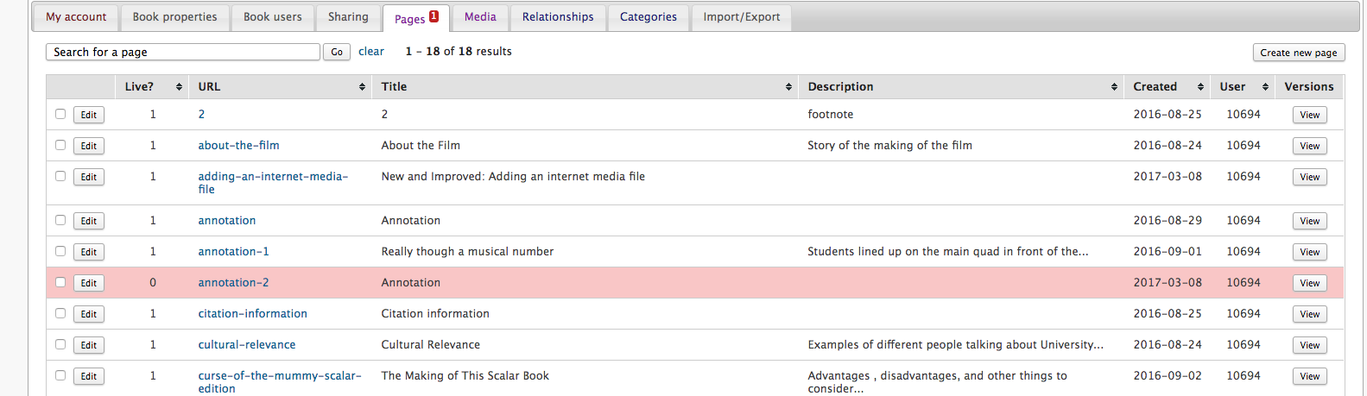
Step 3: Create a Page
Notice: You already have some pages! You annotations have their own pages that show the media and, above the media, the “content” of the specific annotation.

Slide 39
Step 3: Create a Page
Create the first content (not cover) page for your site.
Give the page a title and description.
Add text for this page.
Add media.
Regular version requires keying the media to text. “Inline” version does not.
Select media options, including any particular annotations you want to appear on this page.
For a normal content page: choose “Basic layout” or “Image Header” (which will include a banner image at the top).
For “Image Header” layout, go to “Styling” and select a “Key Image.” Scalar will focus in on a subsection of the image!
“Basic” will show title only. “Image Header” will show the title and also the description in over the key image.

Slide 40
YOUR TURN: Create 3 Content pages
Create 3 pages with text plus at least one media file.
Pages should be three pages you will want to connect together into a reading path for readers (next step!).

Slide 41
Step 4: Create a path
Go to the first page you want to be in the path, and select edit.
Go to the bottom to “Relationships” and “Path.”
Choose all the pages you want to be in the path. Don’t worry about order yet.
Confusing point: select by clicking the text, not the check box.
Drag and drop into the correct reading order for the path.
Select where you want readers to go after finishing the path, if anywhere (could be back to the title page, could be a cited references page, could be anywhere).

Slide 42
YOUR TURN: Create a path out of your pages.

Slide 43
Splash pages and background images.
For book title pages, or chapter title pages. Splash pages are a great way to start a path!
Start a new page.
Go to bottom settings and choose “Book Splash” or “Splash” for the layout. Go to styling and choose the key image that will be the splash image.
The “Book Splash” will show the title of the book and the authors from your settings.
A regular “Splash” will show whatever title you put in the title field.
To make it the start of a path, proceed as before.
Background images:
Set a background image for a particular page in the “styling” options at the bottom of a page.
Set a consistent background image for the entire book in the book properties.

Slide 44
Explore more in Scalar....
Full Scalar documentation:
http://scalar.usc.edu/works/guide2/index
Support Forums:
https://scalar.usc.edu/scalar/forums/
Our Scalar user guide:
http://guides.library.Illinois.edu/scalar

Slide 45
More on Accessibility in Scalar
General: Focus, skip navigation, keyboard navigation
Organization: Paths and Headings
Images: In Scalar, "description"= alt text
Audio and Video: Transcripts

Slide 46
Discuss…
Lingering questions? What did you takeaway from this experience?
How does Scalar’s strengths and weaknesses compare to any other web publishing tools you may have used before?
What were the challenges with Scalar specifically, and what might be challenges with multimodal publishing projects in general?
How do you see yourself using this in your work/with students and faculty/as a library service?

